Slide 1
STRUCTURED QUERY LANGUAGE
- MAYURI .D

Slide 2
PART 1
INSTALLATION OF MYSQL WORKBENCH

Slide 3
INTRO
The MySQL software delivers a very fast, multithreaded, multi-user, and robust SQL (Structured Query Language) database server.
MySQL, the most popular Open Source SQL database management system, is developed, distributed, and supported by Oracle Corporation.
The official way to pronounce “MySQL” is “My Ess Que Ell” (not “my sequel”), but we do not mind if you pronounce it as “my sequel” or in some other localized way.
MySQL is a database management system.-- A database is a structured collection of data.
MySQL databases are relational. --A relational database stores data in separate tables rather than putting all the data in one big storeroom.
MySQL software is Open Source. --Open Source means that it is possible for anyone to use and modify the software. Anybody can download the MySQL software from the Internet and use it without paying anything.
The MySQL Database Server is very fast, reliable, scalable, and easy to use. --MySQL Server can run comfortably on a desktop or laptop, alongside your other applications, web servers, and so on, requiring little or no attention

Slide 4
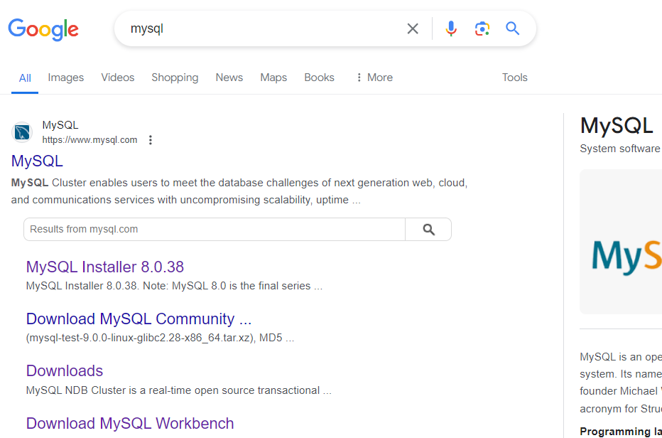
INSTALLATION OF MYSQL
In browser search MYSQL. Open the official site of MySql

Slide 5
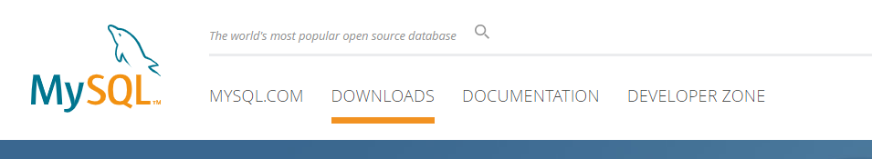
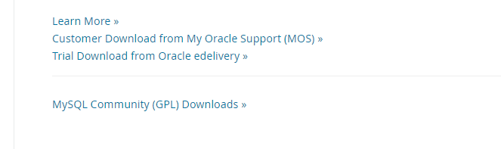
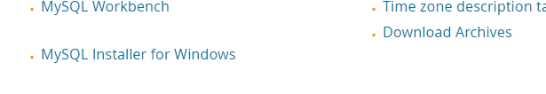
On website select “DOWNLOADS” tab, scroll to the bottom of page and select “MYSQL Community Downloads”. From the given list select “MySQL Installer for Windows”

Slide 6
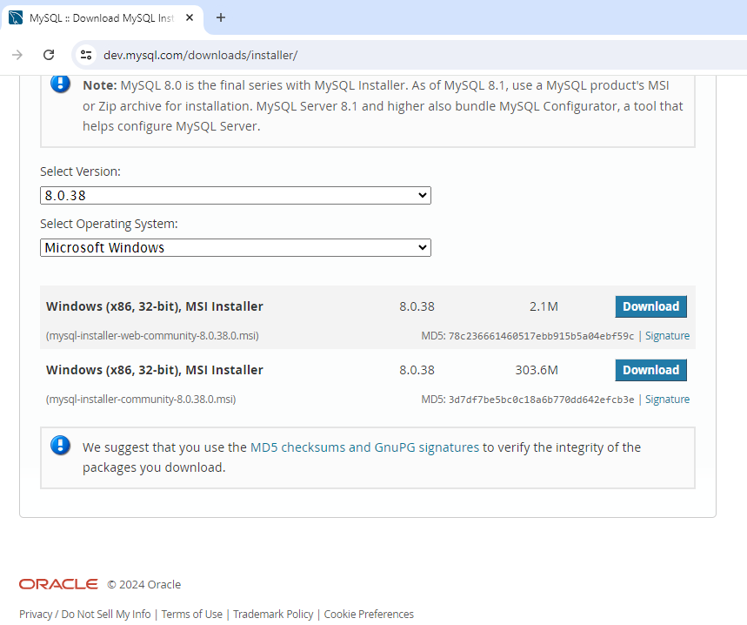
Here you reach to installer page.
You can see which version will be downloaded, some information about MySQL like it is offered by Oracle.
Select installer community to download .exe on your desktop.

Slide 7
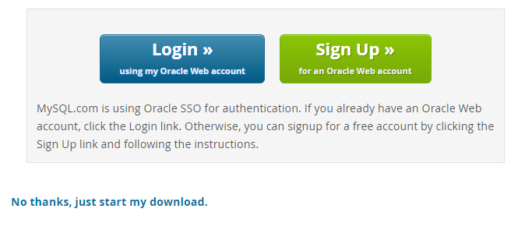
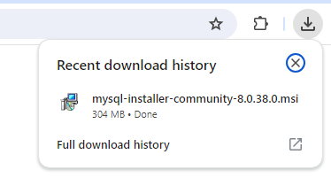
There is no need to login or sign-up, directly start with the download.
Once the download is completed, Click on it to start installation process.

Slide 8
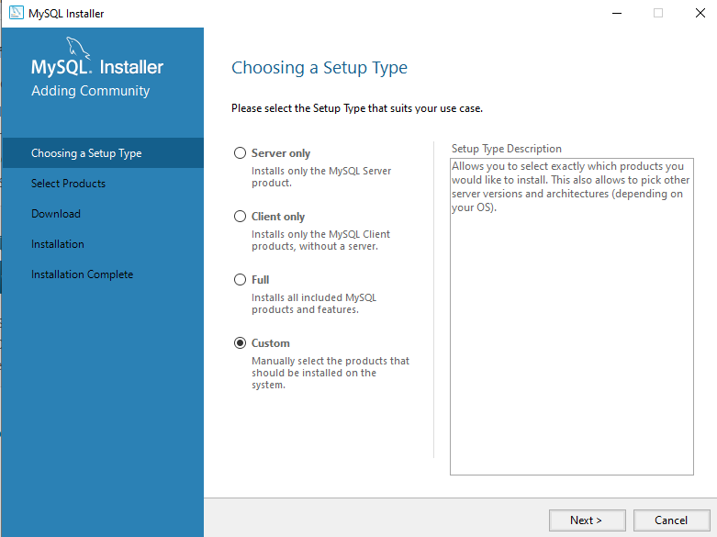
After starting the installation process, you will get windows popup to allow to make changes, click it as YES. Set setup type as CUSTOM as we need to select which products we need. And NEXT

Slide 9
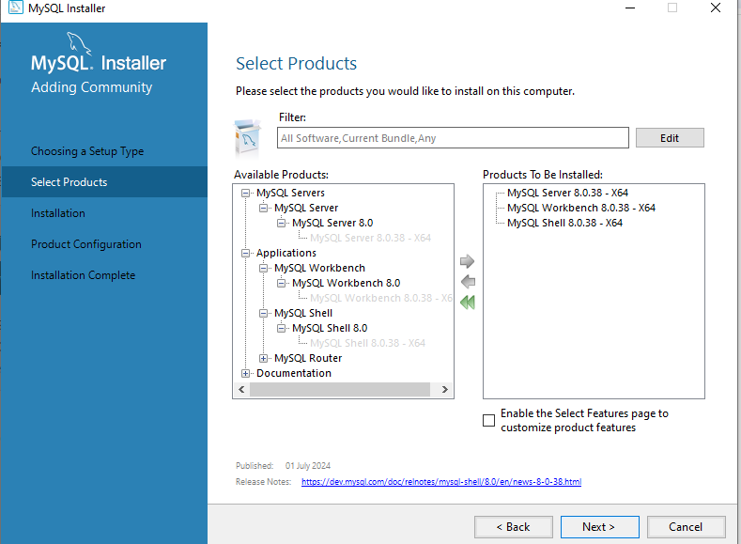
Now you need to select the products.
Expand the options and select server, workbench and shell. Select each product and click on right arrow to move the product in right empty space. And NEXT

Slide 10
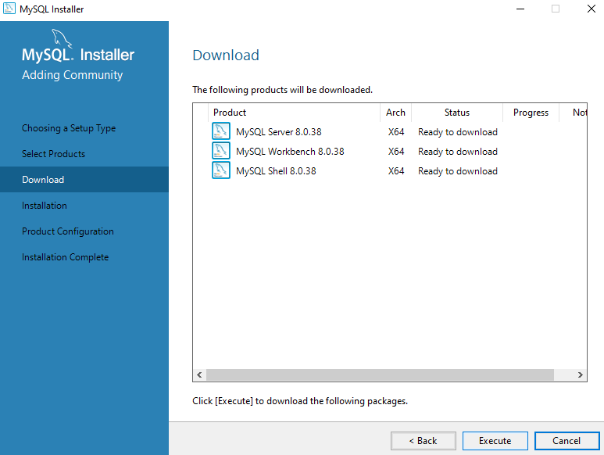
To download selected products on device, click on EXECUTE.
After getting the status as complete and green symbol, click on NEXT

Slide 11
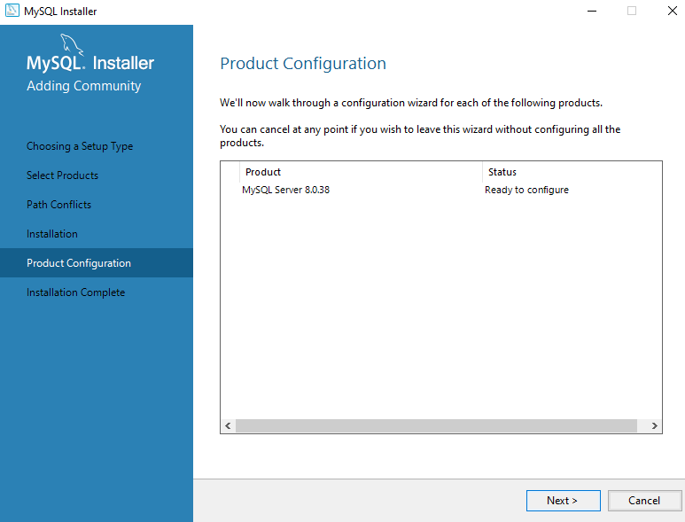
click NEXT for product configuration

Slide 12
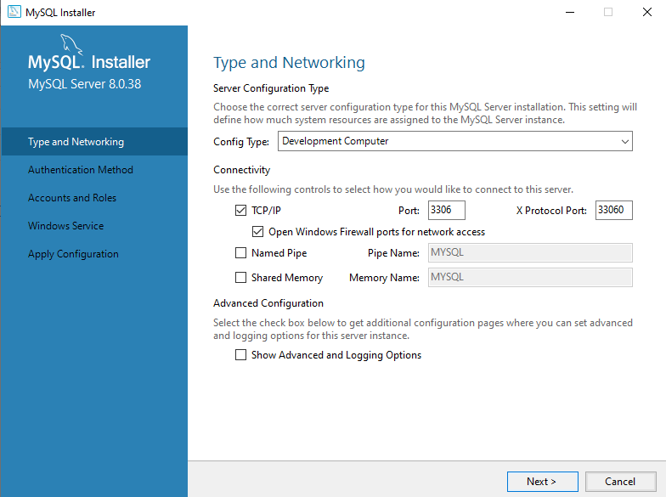
On type and networking, nothing to change just have a look and click NEXT

Slide 13
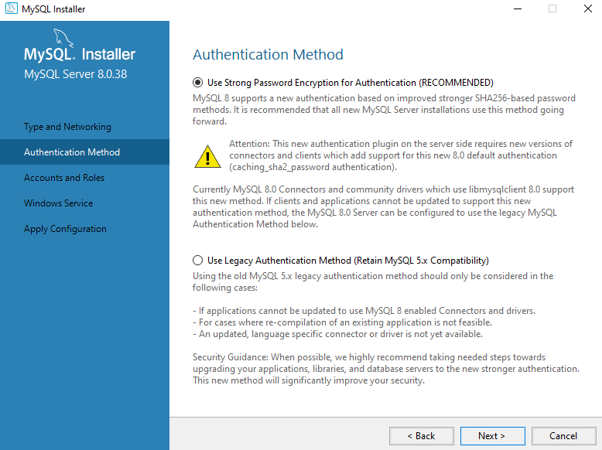
By default, strong password is selected as Authentication method. Keep it as it is and NEXT

Slide 14
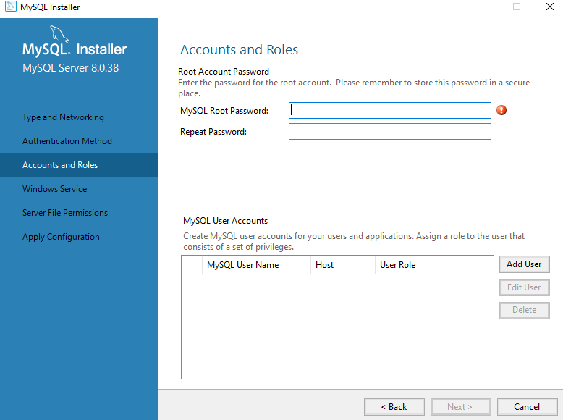
Enter your password and remember it to login further.
Don’t add any user and NEXT

Slide 15
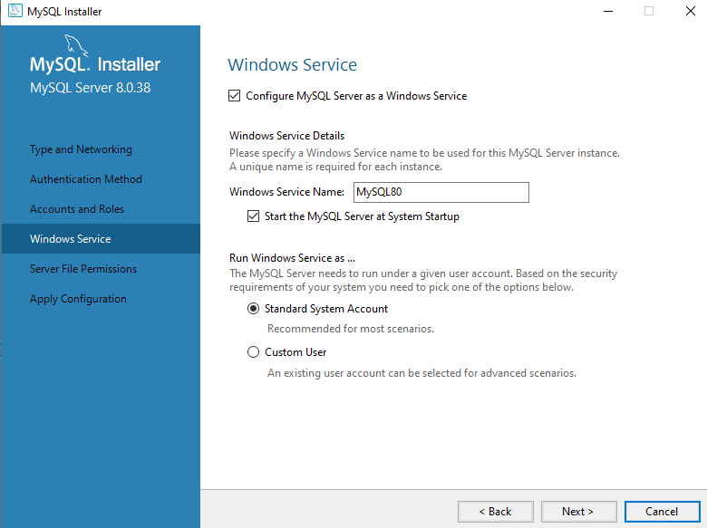
Click NEXT

Slide 16
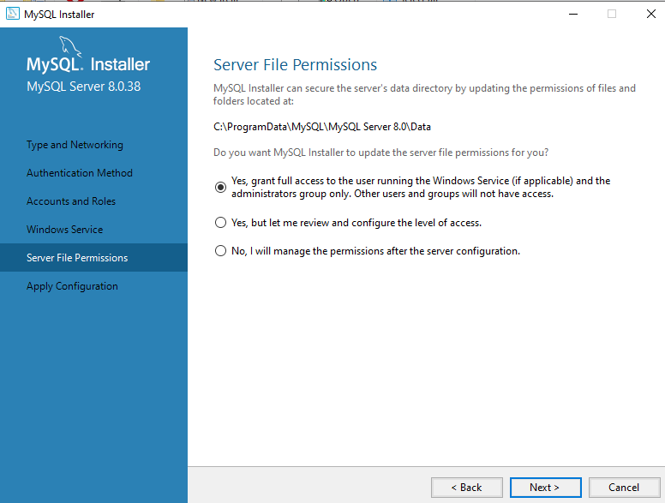
Here is the location path, where all your data will be stored. You can take a backup from this path when you need. Click NEXT

Slide 17

Click on EXECUTE. When all the circles are filled with green tick click FINISH.

Slide 18
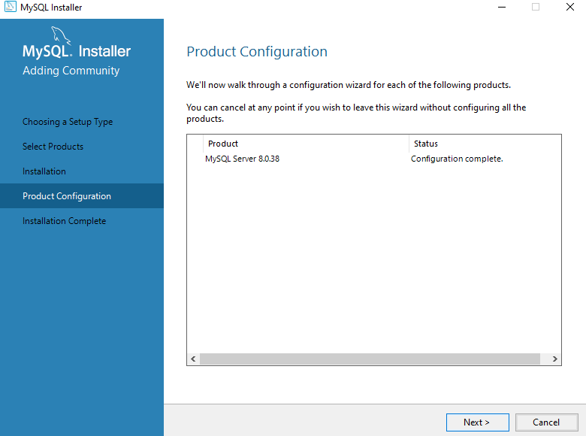
Here the product configuration is completed. Click NEXT

Slide 19
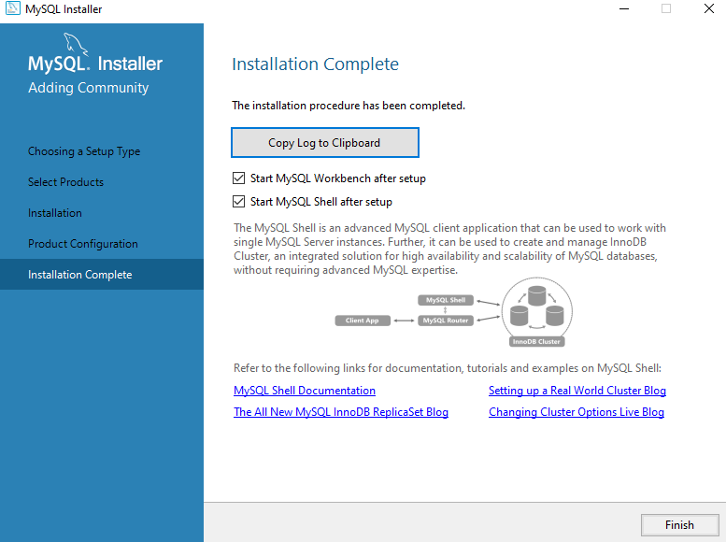
Finally the installation is completed. Click FINISH

Slide 20
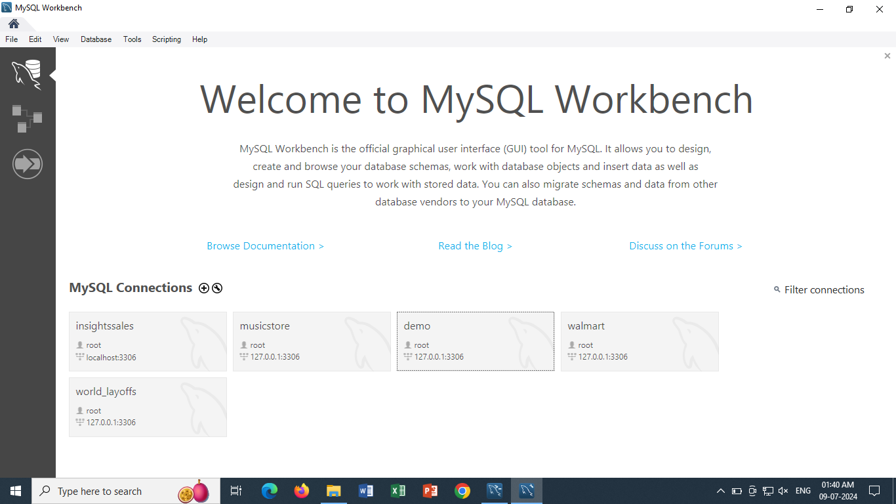
This is the welcome screen of MySQL Workbench, which opens automatically after installation.
As a new user, you will see only one connection on your screen by default.

Slide 21
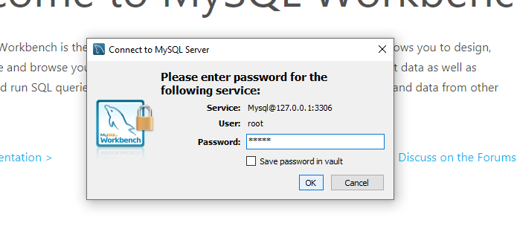
Select the by default connection you see on your screen and popup comes to enter the password.
Enter your password that you set during installation process, tick to save it so you don’t need to enter password everytime you open workbench. And OK

Slide 22
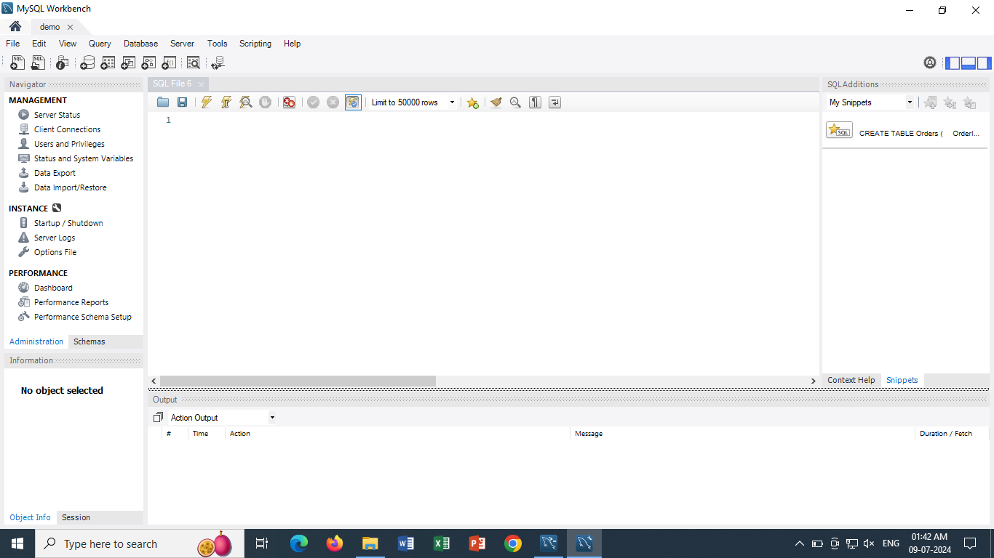
This is the overview of your MySQL workbench editor, place where you will perform queries.

Slide 23
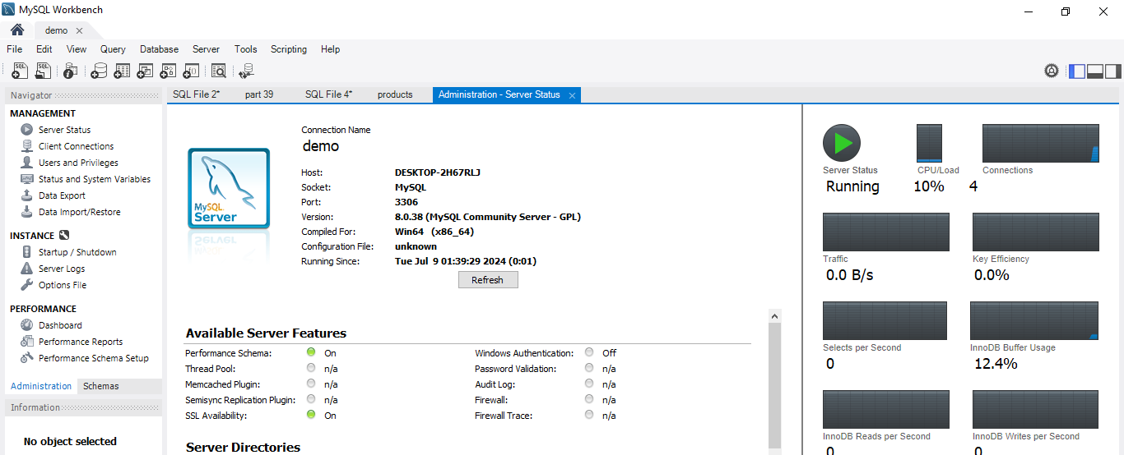
To check whether your installation is done properly or server is connected, go to Administration → server status → see whether the status is running

Slide 24
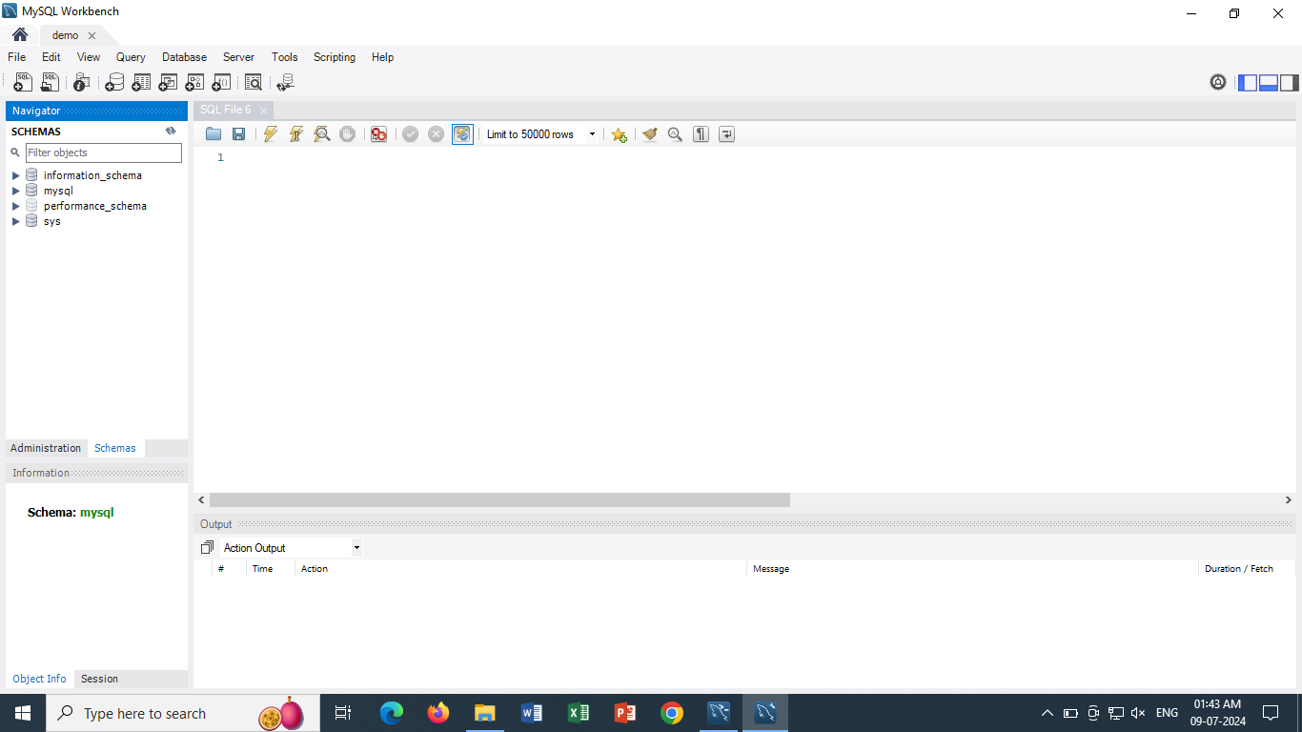
Overview of MySql Workbench
5
1
3
2
4

Slide 25
Sections of MySql
Section where your Databases and tables are displayed
Section where information of selected table is displayed
Section where you perform queries
Section where the output status of queries are displayed
You can turn on/off any section as per need.

